Slide 1
Mixture Density Networks
One way to model the probability distribution
and the uncertainty estimation

Slide 2
Agenda
Cover basics of Mixture Models
Cover basics of (ANN)
MDN in depth

Slide 3
Algorithms
Mixture Models
Artificial Neural Networks
Mixture Density Networks

Slide 4
Mixture Models

Slide 5
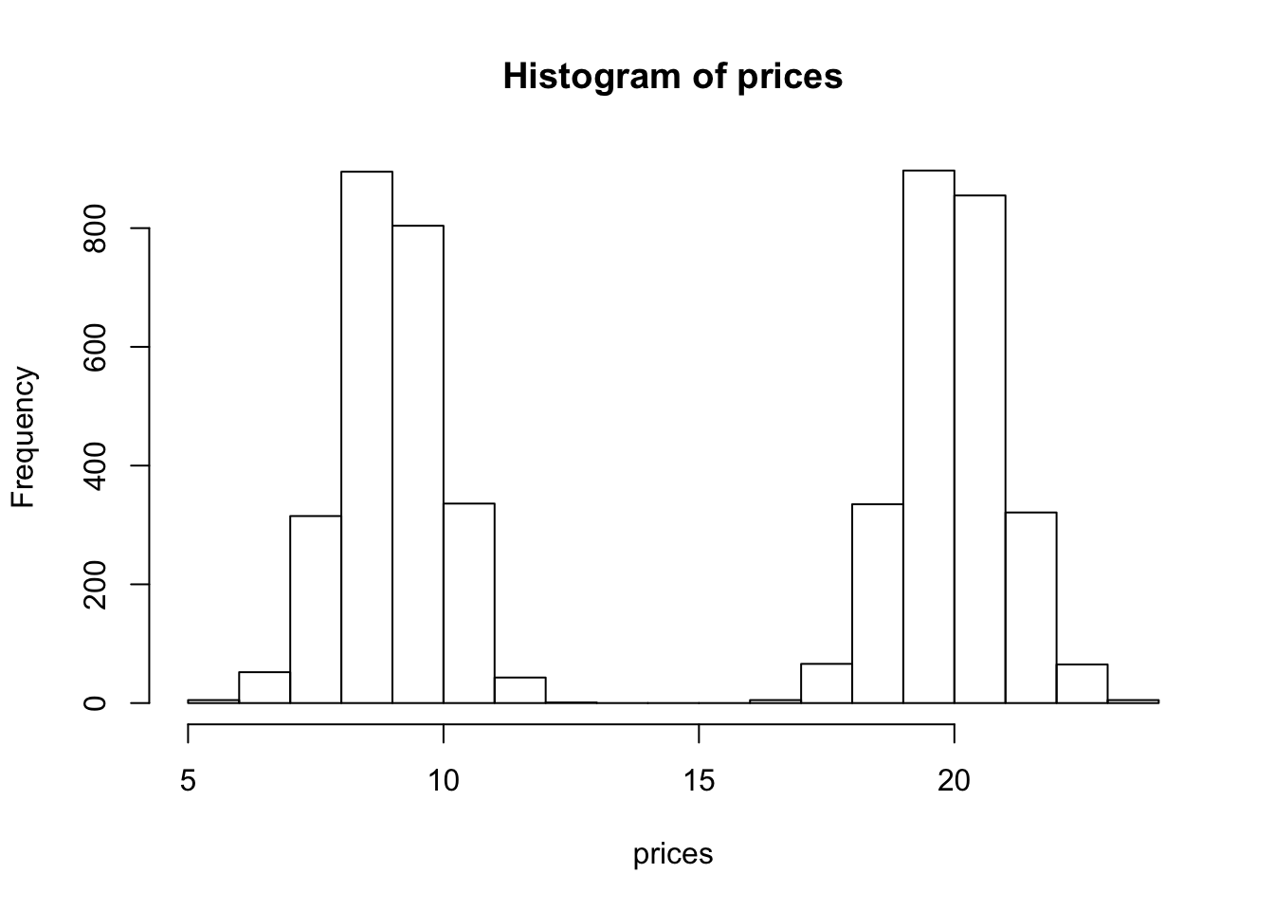
Overview
We often make simplifying modeling assumptions when analyzing a data set such as assuming each observation comes from one specific distribution (say, a Gaussian distribution). Then we proceed to estimate parameters of this distribution, like the mean and variance, using maximum likelihood estimation.However, in many cases, assuming each sample comes from the same unimodal distribution is too restrictive and may not make intuitive sense. Often the data we are trying to model are more complex. For example, they might be multimodal – containing multiple regions with high probability mass. In this note, we describe mixture models which provide a principled approach to modeling such complex data.

Slide 6
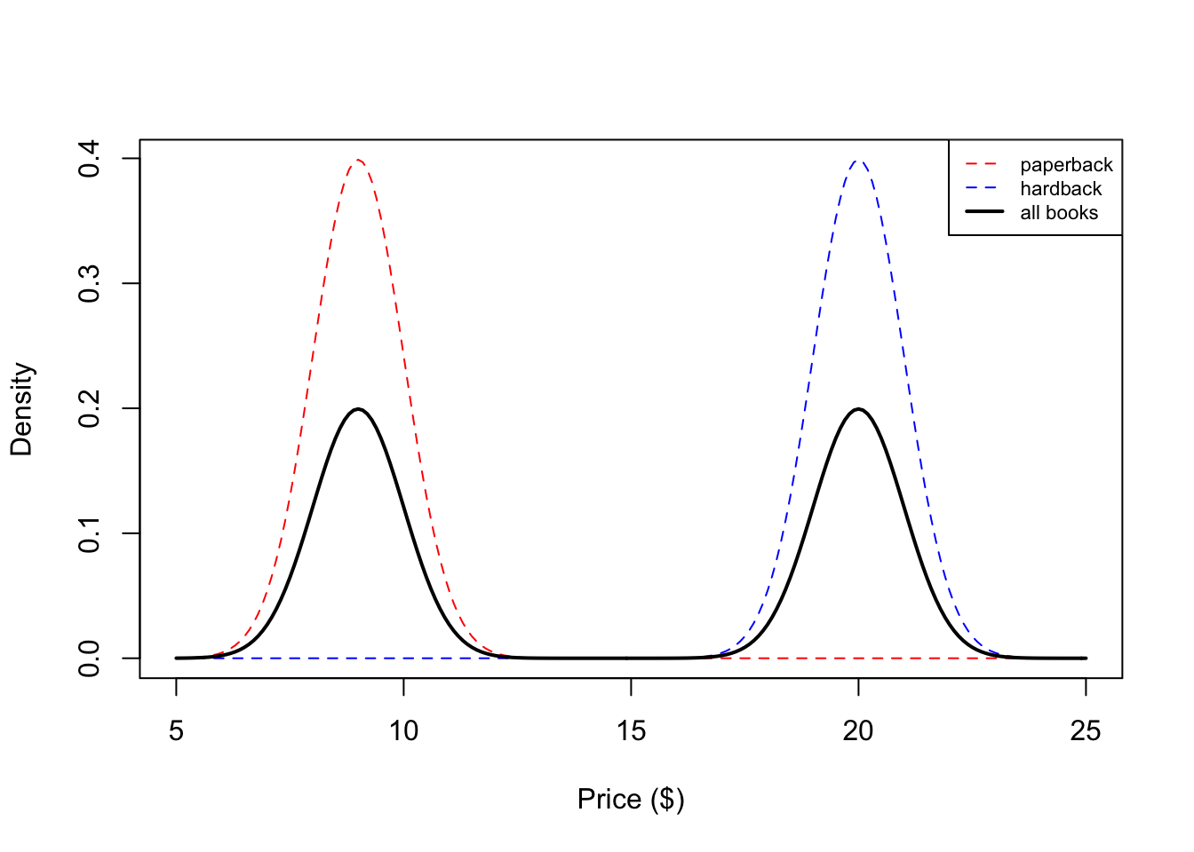


Overview
The mixture distribution is formulated as:
The Gaussian mixture component
Formulated as:
as:

Slide 7
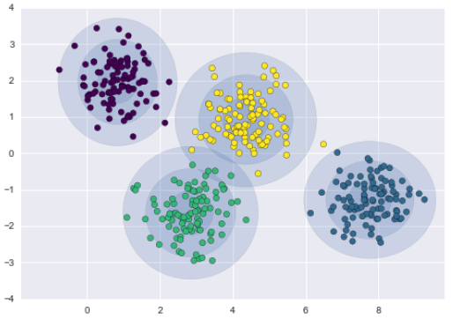
Mixture Models: Usage / Application
Cluestirng (Unsupervised)
Density Estimation
Features extractions from speech data
use in speech recognition systems
Classification(supervised) naive Bayes classifier

Slide 8
Mixture Models: Input Variables / Features
Numerical values (Using pdf)
Categorical values (Using pmf)
Needed to encoded
probability distributions for categorical (discret) variables
Bernoulli ,Binomial, ...ie.
probability distributions for numerical (continuous) variables
Gaussian,Exponential , ...ie.

Slide 9



Mixture Models: Technical Foundation
K is mixture components.
Zi∈{1,…,K} which indicates which component Xi came from ,Zi’s are sometimes called latent variables.
Xi are observations sampled from one of K component.
πk are called mixture proportions or mixture weights and they represent the probability that Xi belongs to the k-th mixture component
P(Xi|Zi=k) the mixture component, and it represents the distribution of Xi.
The marginal probability of Xi is:
Mixture component pmf for discrete variables:
Mixture component pdf for continuous variables:

Slide 10

Mixture models:parameter estimation
Expectation-Maximization(EM) algorithm.
Goal construct maximum likelihood estimators(MLEs):
Attempting to obtain maximum estimates parameters by directly maximizing the observed data.
Maximum likelihood function:

Slide 11

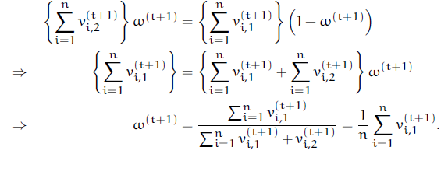
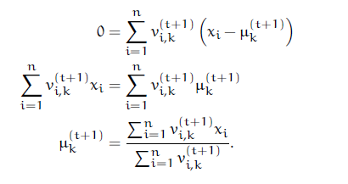
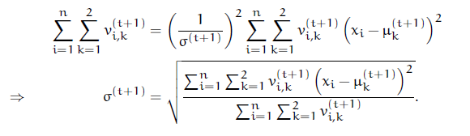
Expectation-Maximization(EM) algorithm
Two steps :

Slide 12
How many components?
Analytic criterion such as :
The Akaike information criterion (AIC).
The Bayesian information criterion (BIC).

Slide 13
Neural networks

Slide 14
What is neural network?
A neural networks is a network of artificial neurons -nodes, where each nodes has multiple inputs, and multiple outputs that are determined by the processing done in its core.

Slide 15
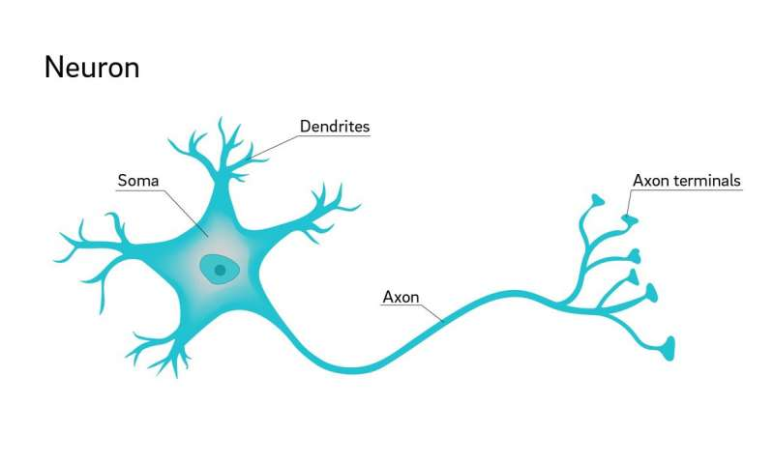
The anatomy of neuron
key idea that inspired artificial neural networks

Slide 16
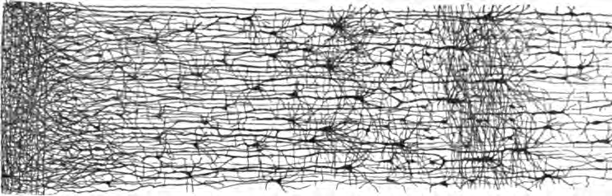
Multiple layers in a biological neural network

Slide 17
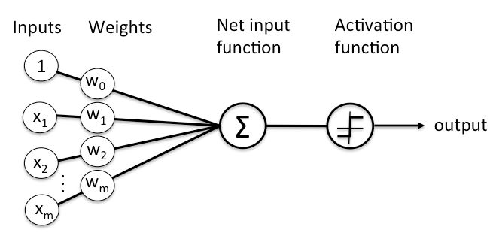
The structure of a perceptron

Slide 18
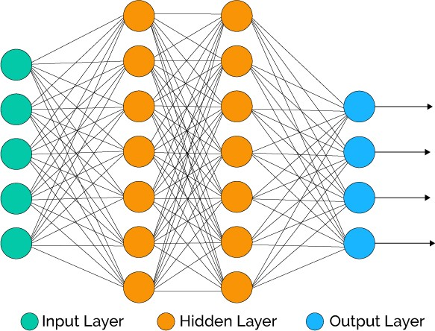
Structure of a Deep Neural Network

Slide 19
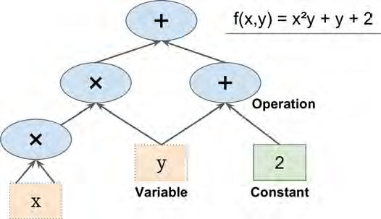
TensorFlow

Slide 20
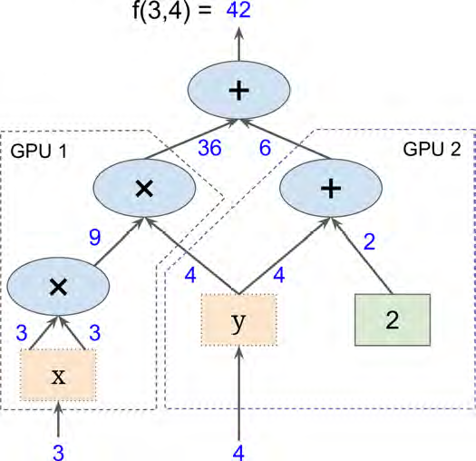
TensorFlow
Parallel computation on multiple CPUs/GPUs/servers
Break up the graph into several chunks
Run in parallel across multiple CPUs or GPUs
TensorFlow supports distributed computing
so you can train colossal neural networks
splitting the computations across hundreds of servers
TensorFlow can train a network with millions of parameters
It runs on Windows, Linux, and macOS, also on mobile devices
Including both iOS and Android.
Runs quantum physics simulations.

Slide 21
Mixture Density Network(MDN)
One way to model the probability distribution
and the uncertainty estimation

Slide 22
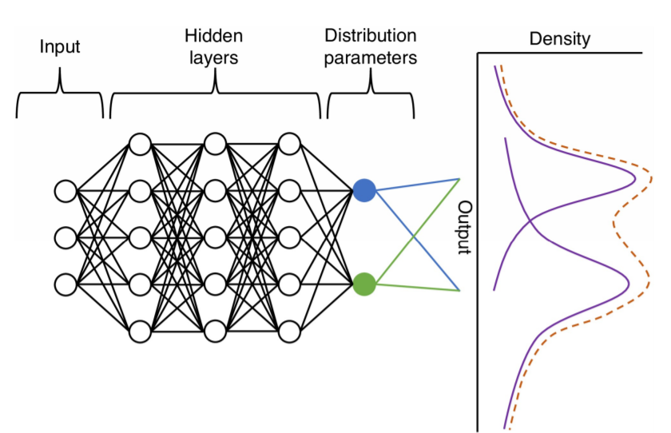
Abstract
Mixture density networks (MDNs) are built from two components a neural network and a mixture model. A mixture model of probability distributions built up from a weighted sum of more simple distributions.Consider a one-dimensional distribution with m mixture components. The probability density function is represented by the m PDFs .

Slide 23
Usage/Application areas
Regression
Classification
Simulation and emulation
Speech synthesis
Uncertainty estimation
-Siri’s Voice: On-device Deep Mixture Density Networks for Hybrid Unit Selection Synthesis.
-Emulation of complex epidemiological .

Slide 24
MDN Input Variables / Features
Numerical values (Using pdf)
Categorical values (Using pmf)
Needed to encoded
probability distributions for categorical (discret) variables
Bernoulli ,Binomial, ...ie.
probability distributions for numerical (continuous) variables
Gaussian,Exponential , ...ie.

Slide 25
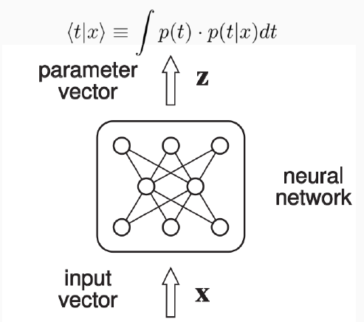
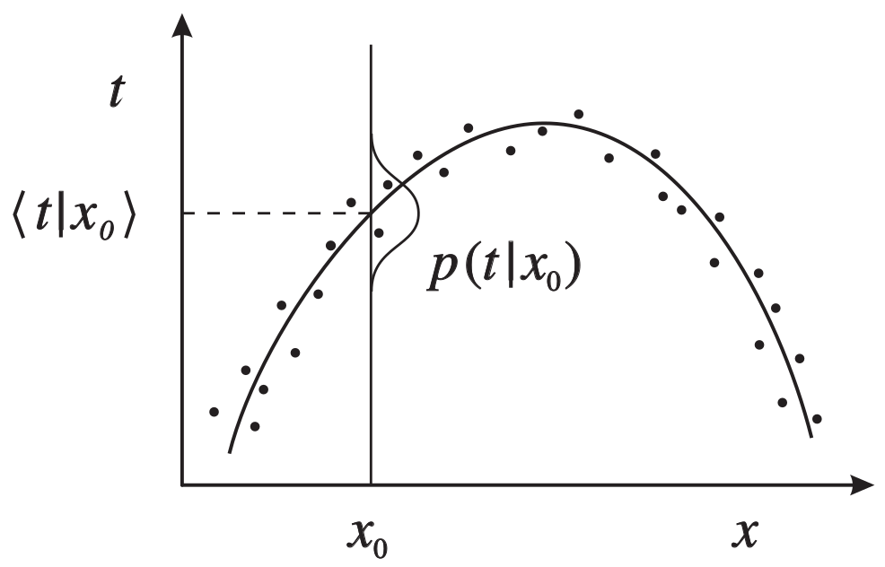
Standard Neural Network limitation:
Standard Neural Network limitation:
According to Bishop in his article Mixture Density Networks, a typical Neural Network (NN) approximates the conditional average of the target data, conditioned on the input vector.

Slide 26
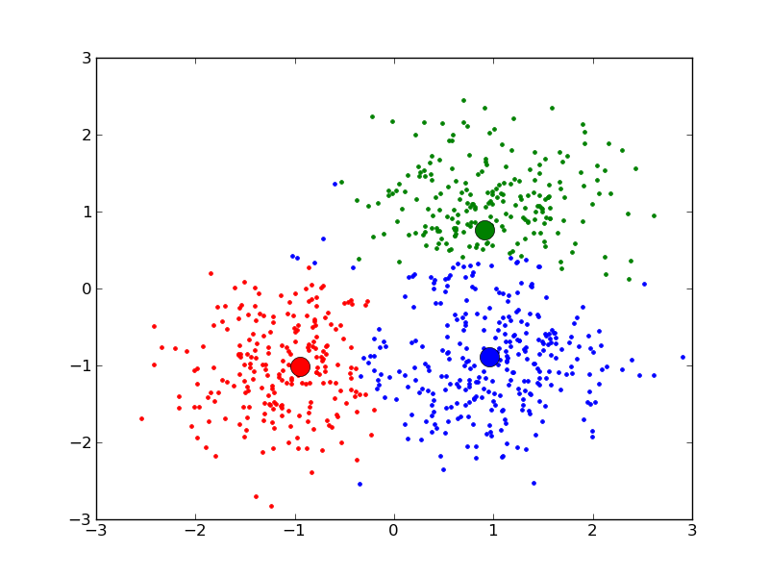
Standard Neural Network limitation:
For classification problems:
These averages represent the
posterior probabilities of
class membership (it can be
regarded as optimal with a
suitable chosen target coding
scheme).

Slide 27
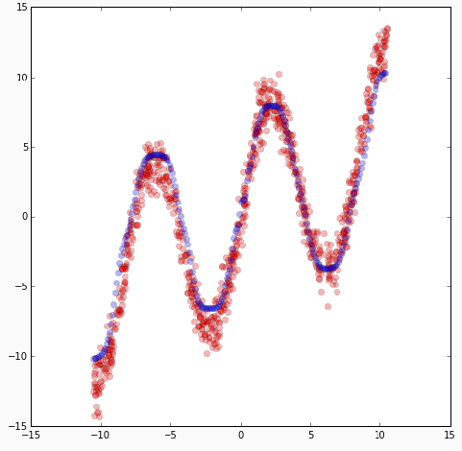
Standard Neural Network limitation:
For regression problems: The
conditional averages provide
a very limited description of
the properties of the target
variable.

Slide 28
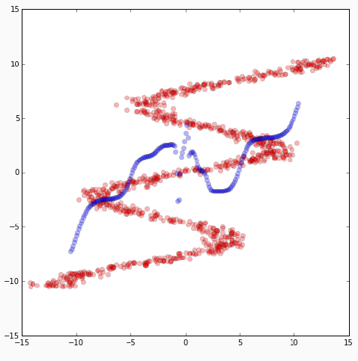
Standard Neural Network limitation:
For approximating distributions problems: The average of several correct target values is not necessary itself a correct value.

Slide 29
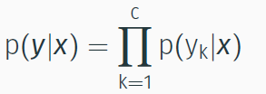
possible solution
To solve these problems, we must model the conditional probability distribution of the target data conditioned on the input vector.
Once we have modelled the distribution of probabilities, we could model the uncertainty of a certain prediction?

Slide 30
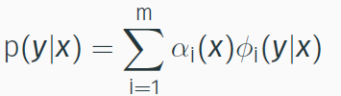

MDN: Technical Foundation
The probability density of the target data is then represented as a linear combination of kernel functions in the form
where m is the number of components in the mixture and αi(x) are called mixing coefficients(prior probability).
Øi(t | x) represent the conditional density of the target vector t for the ith kerne.
And selected the kernel functions which are Gaussian of the form:
where µi represents the center of the ith kernel. We assumed that the components of the output vector were statically independent within each component of the distribution, and it can be described by a common variance σi(x).

Slide 31
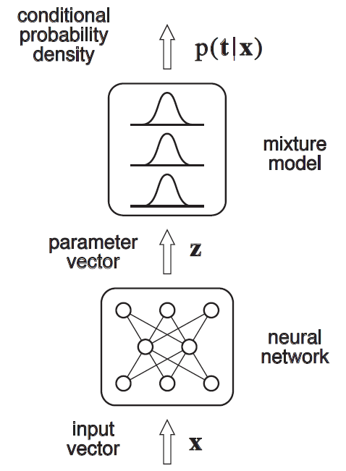
The network outputs: Forward step

Slide 32
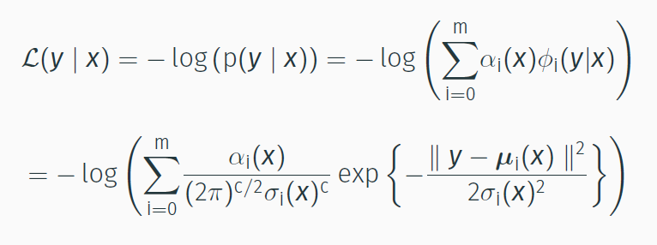
The Backward step: How to train this model
To estimate the output parameters, following to the Maximum Likelihood Estimation method (MLE), we can define a loss function which requires the minimisation of the negative log-likelihood function:

Slide 33
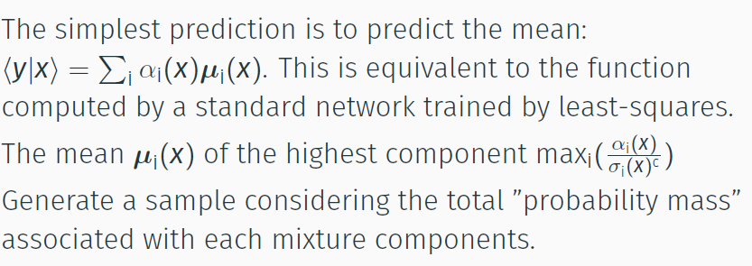
How to make predictions using MDNs?

Slide 34
MDN:Modeling Building
Apply weight regularisation to to avoid overfit σ(xi).
Apply Batch normalisation technique to speed run time.

Slide 35
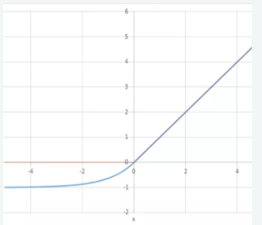

MDN:Modeling Building
Clipping of the α(x) and σ(xi) parameters values.
Exponential Linear Unit or its widely known name ELU is a function that tend to converge cost to zero faster and produce more accurate results

Slide 36
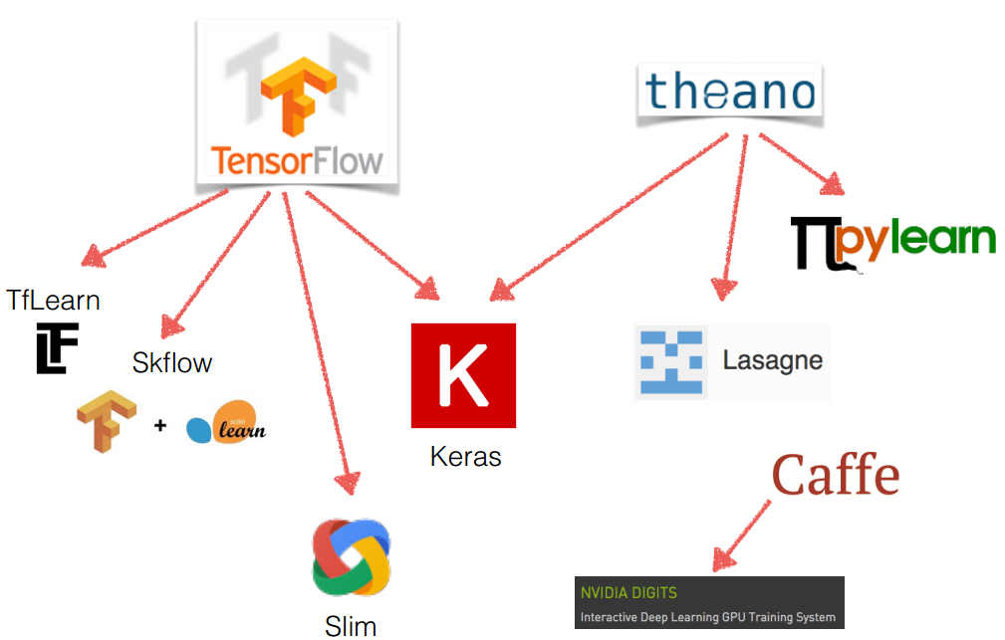
The software library used

